Slide 1

Techplatform-site
Hima bindu 3/7/25

Slide 2

Introduction of our platform
TechPlatform-Site is a cloud-based, modular technology platform designed to development workflows.
TechPlatform-Site is a modern, scalable, and user-friendly platform designed
Our wed site (techplatform-site) is establish by 2005
Why Choose Our Platform?
TechPlatform.in provides cutting-edge technology solutions tailored to your business needs.
24/7 Customer Support
Enterprise-grade Security
Scalable Infrastructure
99.9% Uptime Guarantee

Slide 3
Explanation of our wedsite :
TechPlatform-Site – Cloud-Based Development Solution
TechPlatform-Site is a modern, scalable, and user-friendly cloud-based platform designed to streamline development workflows. Established in 2005, our platform empowers developers, IT professionals, and businesses with cutting-edge tools and infrastructure to accelerate innovation.
Modular & Scalable – Adaptable architecture for seamless workflow integration.
Enterprise-Grade Security – Robust protection for your data and applications.
99.9% Uptime Guarantee – Reliable performance with minimal downtime.
24/7 Customer Support – Expert assistance whenever you need it.

Slide 4
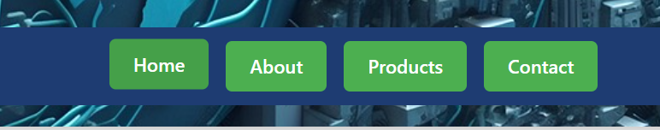
TechPlatform-Site Website Navigation
Our website is structured into four main sections for easy access:
Home – Discover an overview of TechPlatform-Site, its features, and key benefits.
About – Learn about our mission, history, and the team behind the platform.
Product – Explore our modular solutions, technical capabilities, and use cases.
Contact – Reach out for support, partnerships, or inquiries.

Slide 5
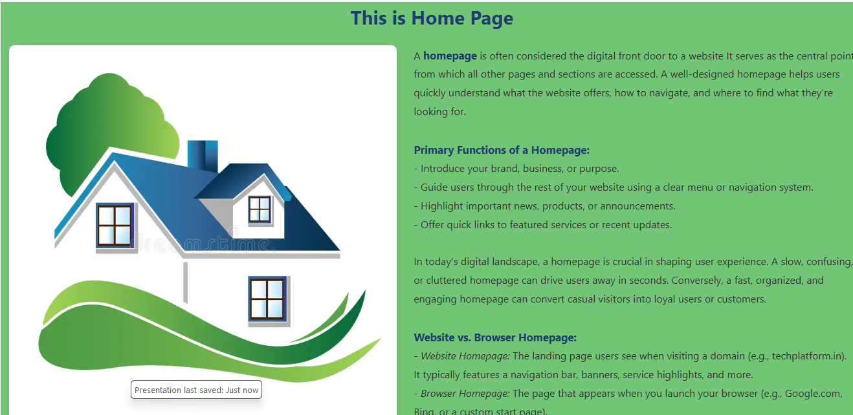
TechPlatform-site Homepage
Title: "This is Home Page“
Text Content:
  Definition of a homepage
  Tips for a successful homepage
  Importance of layout and user flow
  Visual: Large home icon with greenery

Slide 6

Why Choose Our Platform?
24/7 Customer Support
Secure platform
Scalable infrastructure
10+ Years Experience - Trusted by 500+ businesses worldwide
Award-Winning Platform - Recognized for innovation and reliability
Our team of experts is dedicated to delivering exceptional service and innovative solutions.

Slide 7

Key Features Section
High performace : refers to the platform’s ability to deliver fast, reliable, and responsive services, regardless of the size or complexity of the project.
Secure Platform:prioritizes data protection, user privacy, and system integrity, making it a trusted platform for businesses and developers.
24/7 Support: TechPlatform.in offers round-the-clock technical and customer support, ensuring that users get help any time they need no delays, no downtime.
Scalable Solutions: TechPlatform.in is built to grow with your business.

Slide 8
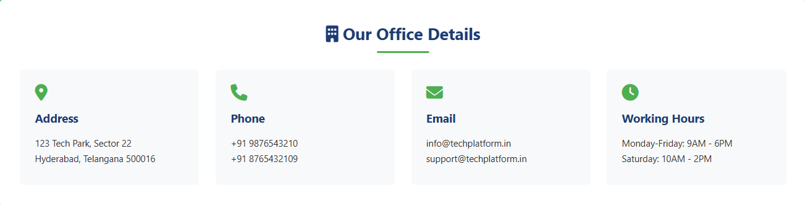
Contact Info Block:
Address: Hyderabad, Telangana
Phone: +91 8747842132
Email: info@techplatform.in
Working Hours: Mon–Fri: 10AM–6PM, Sat: 10AM–2PM

Slide 9
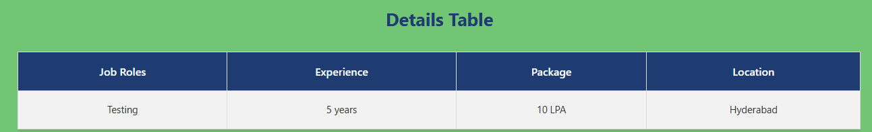
Job Details Table
The Job Details Table is a section of the homepage that briefly lists current job openings at TechPlatform.in. It provides a quick snapshot of available roles, requirements, and compensation to attract potential applicants.

Slide 10
Footer section
Social media icons are small clickable graphics (usually logos) placed on the website—typically in the footer—that link to the platform’s official social media pages. These icons help users connect with the brand across various online communities.
🔵 Facebook
🐦 Twitter (X)
📸 Instagram
💼 LinkedIn
▶️ YouTube

Slide 11
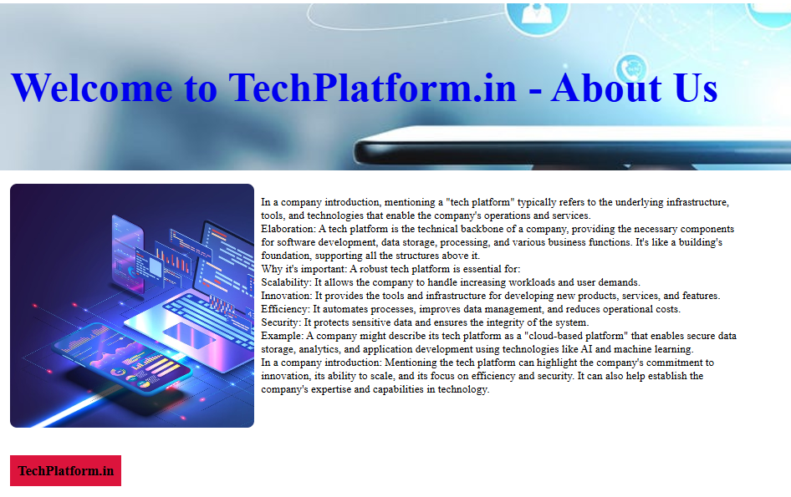
Techplatform-site about
This is about page
In the about page we are creating a hyperlink to the about redirection (welcome to techplatform.in is a hyper link )
Add one logo on about page and add some css style on it
Here also add footer in bottom of the page
This history of our wed site

Slide 12

Techplatform.in products page
This is a product of our wed site , here mainly four
Voice, non voice, testing and development .

Slide 13
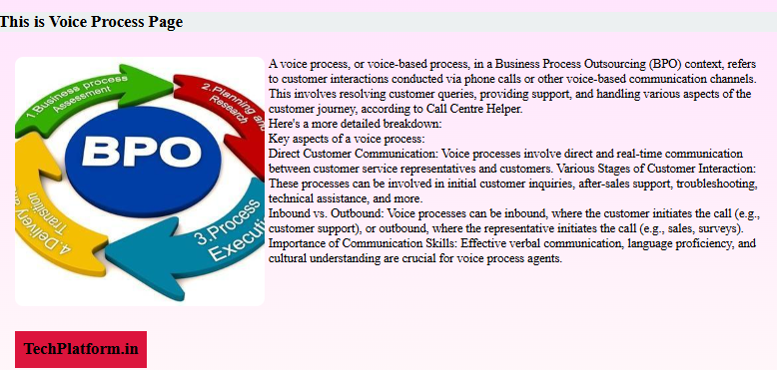
Voice process of products
A Voice Process involves handling customer interactions over the phone. It’s a part of Business Process Outsourcing (BPO) where representatives speak directly to customers to solve issues, provide support, or conduct sales.
Types of Voice Process:
Inbound Voice Process
Outbound Voice Process

Slide 14
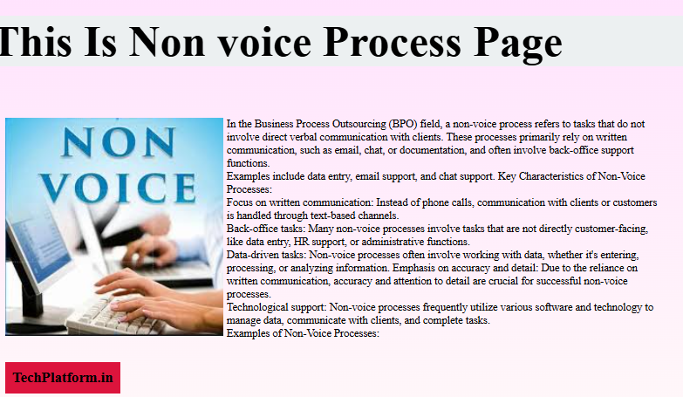
Non voice process of products page
A Non-Voice Process involves supporting customers without verbal interaction — instead, through written communication such as email, chat, or data entry.
It is commonly used in IT support, customer service, data management, and back-office operations.
Types of Non-Voice Processes
1.Data Entry & Back Office 2. Email Support 3. Content Moderation
4.Chat Support

Slide 15
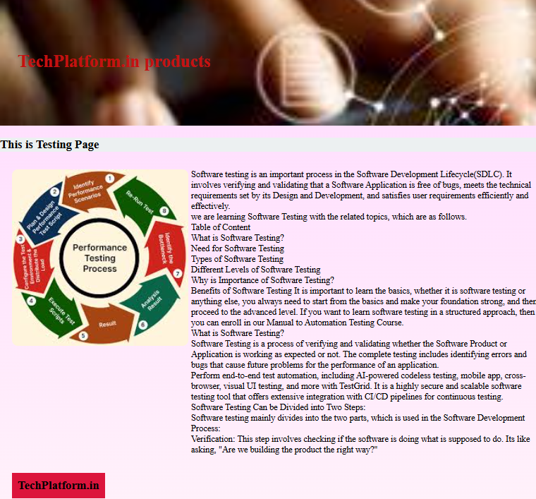
Testing in products page
Software Testing is the process of evaluating a software application to find and fix bugs, errors, or performance issues before it is released to users. It ensures the software meets quality standards and behaves as expected.
Types of Testing:
Manual Testing , 2. Automation Testing , 3. Functional Testing
4. Performance Testing 5. Security Testing 6. Regression Testing

Slide 16
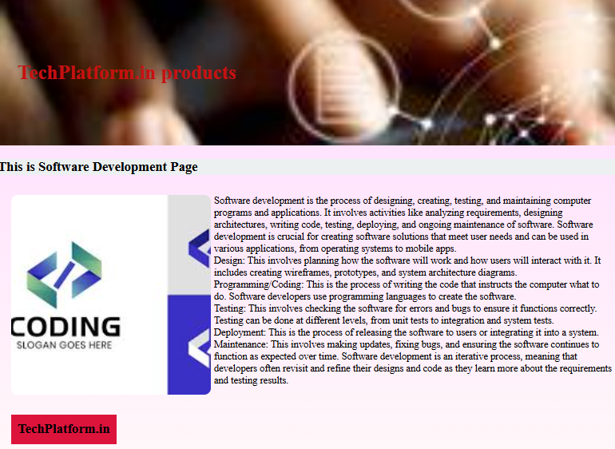
Software development of product pages
Software Development is the process of designing, building, testing, and maintaining software applications. It involves converting business or user needs into functional digital solutions like web apps, mobile apps, or enterprise systems.

Slide 17

Contact form in techplatform
A Contact Form is an online form that allows website visitors to send messages, inquiries, or feedback directly to the website owner or support team. It acts as a direct communication channel between users and the business.

Slide 18
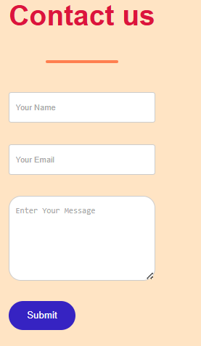
Contact us of contact form
Contact form cantact hyperlink to redirected to homepage
Contact us cantain :
Name, Email , Phone, Subject or Message

Slide 19
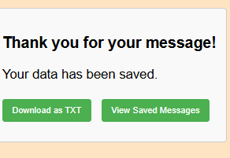
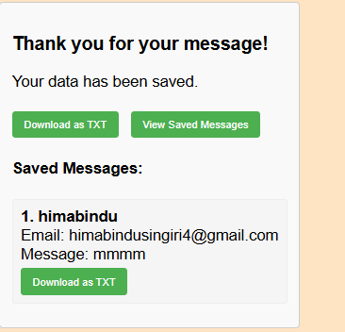
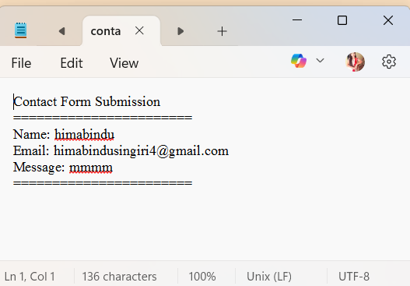
Local stored in contacts us
in this contact form when I click name ,email ,and massage click on submit button it shows view massage button is showing the massage
We want download the text download.txt click on the data stored in note pad in our by using local storage
By using local storage in our wed site , inspect code show in local storage data is stored in that local storage

